Slide 1


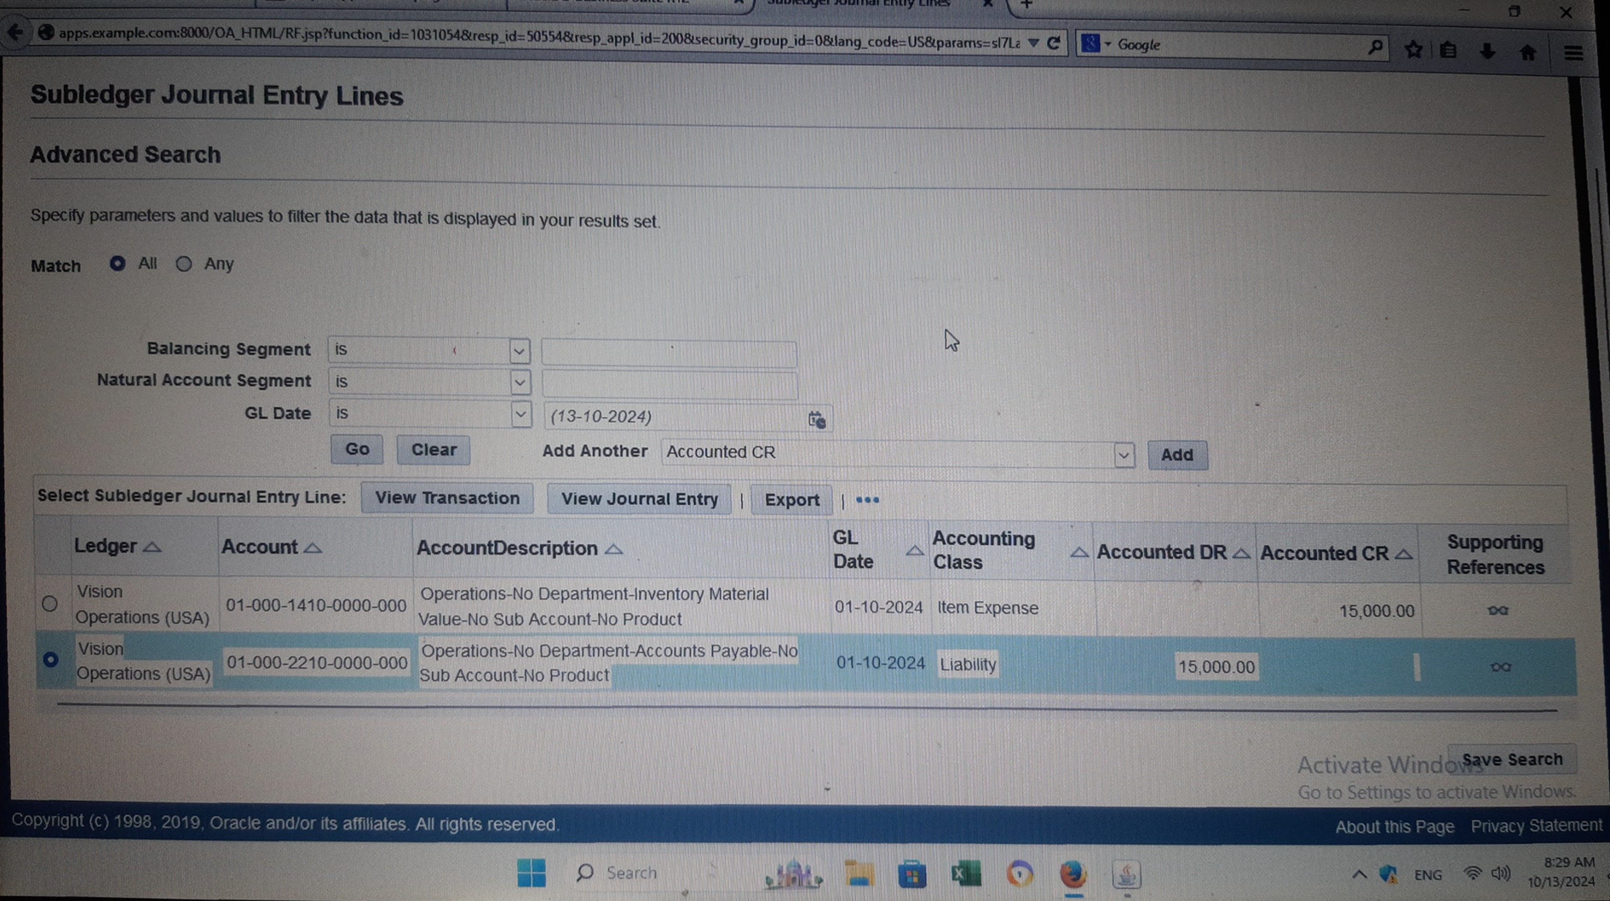
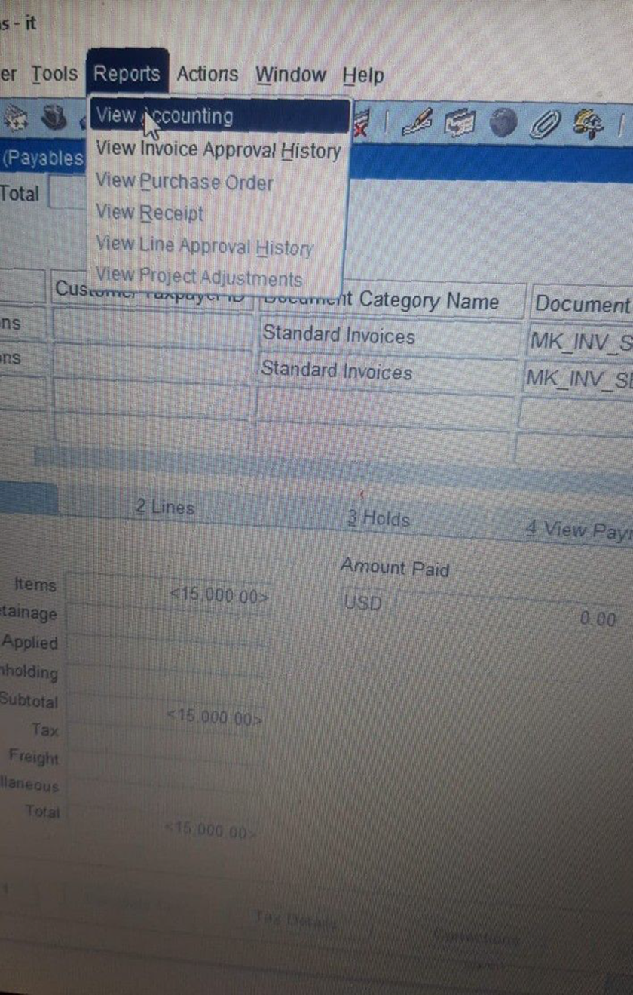
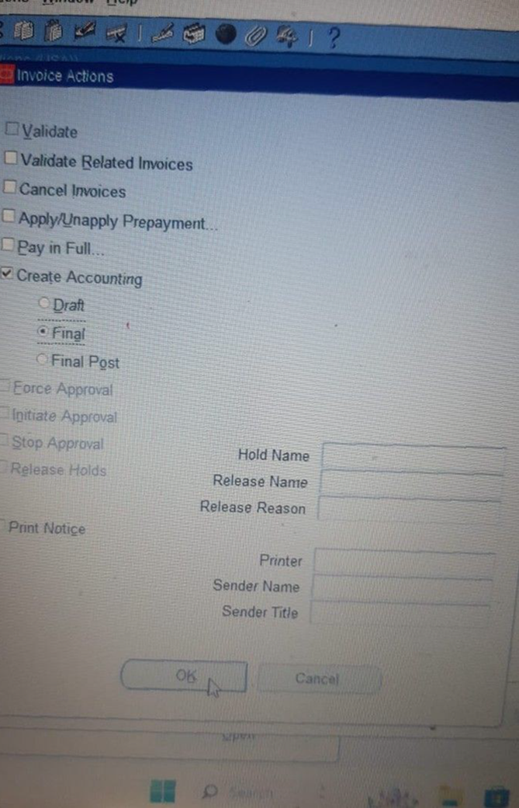
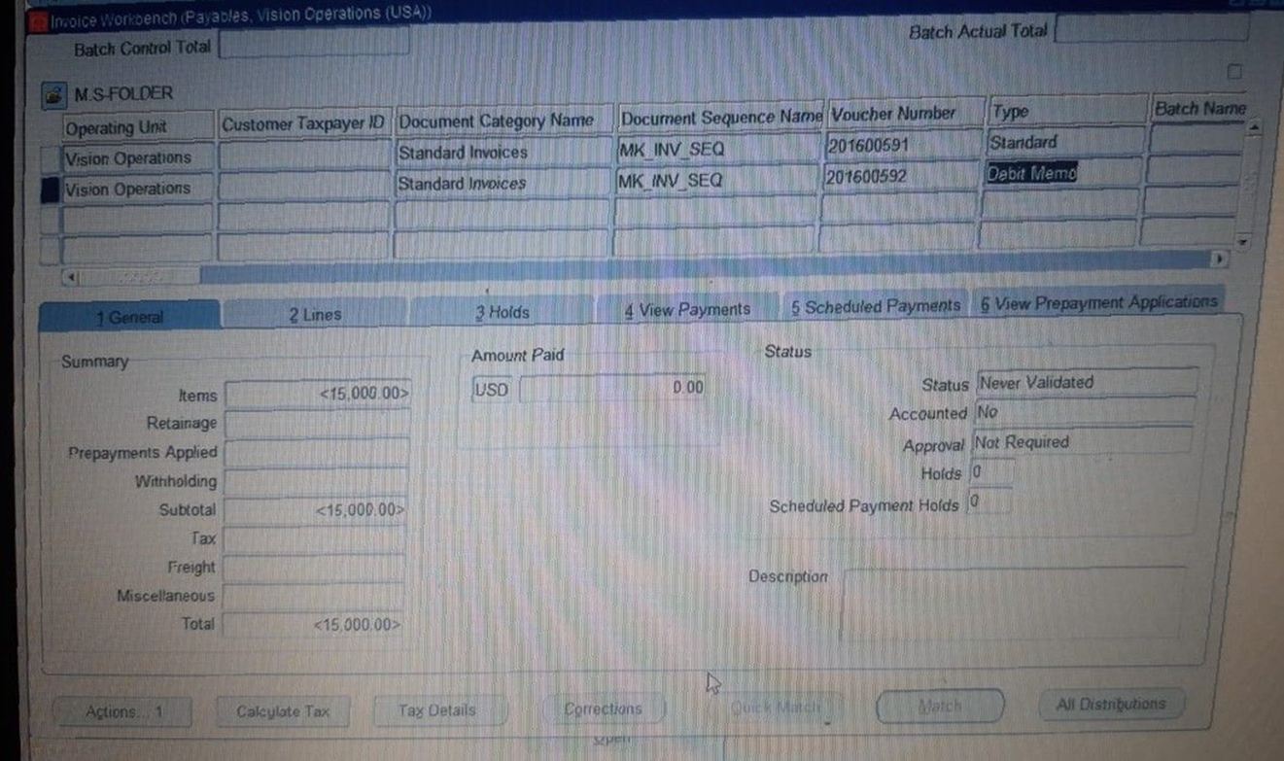
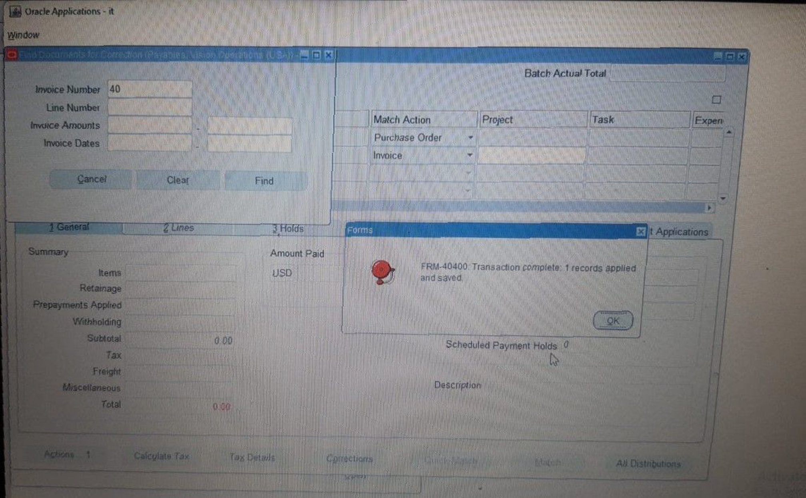
Create and Manage Supplier Invoices
Creating Invoices​
Click The Invoice Number then Find +OK
Action > Validate
Action > Create Accounting > Final> OK
Report > View Accounting
20

